Slide 1
OOP & TDD
August, 2016

Slide 2
Agenda
Object Oriented Programming (OOP)
Class & Objects
Methods and Attributes
Interface
Test Driven Development (TDD)

Slide 3
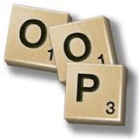
OOP
1
Object-oriented programming (OOP) refers to a type of computer programming (software design) in which programmers define not only the data type of a data structure, but also the types of operations (functions) that can be applied to the data structure.
2
3
4
In this way, the data structure becomes an object that includes both data and functions. In addition, programmers can create relationships between one object and another.
5

Slide 4
Class & Objects
1
Class is an extensible program-code-template for creating objects, providing initial values for state (member variables) and implementations of behavior (member functions or methods).
2
3
4
Object refers to a particular instance of a class where the object can be a combination of variables, functions and data structures.
5

Slide 5
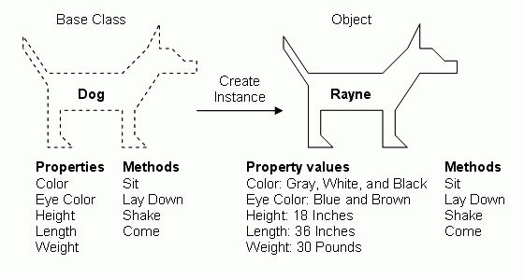
Class & Objects
1
2
3
4
5

Slide 6
Methods and Attributes
1
The behavior of class or its instances is defined using methods. Methods are subroutines with the ability to operate on objects or classes. These operations may alter the state of an object or simply provide ways of accessing it.
Attributes are data field descriptions (or properties, fields or data members). These are usually field types and names that will be associated with state variables at program run time; these state variables either belong to the class or specific instances of the class.
2
3
4
5

Slide 7
Interface
An interface is a description of the actions that an object can do...
For example, say we have a car class and a scooter class and a truck class. Each of these three classes should have a startEngine() action. How the "engine is started" for each vehicle is left to each particular class, but the fact that they must have a startEngine action is the domain of the interface.
1
2
3
4
5

Slide 8
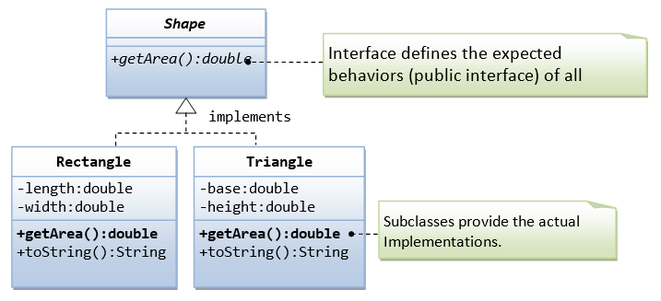
Interface
1
2
3
4
5

Slide 9
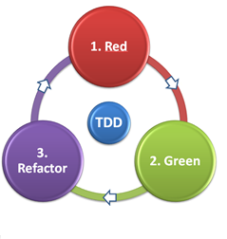
TDD
1
"Arrange-Act-Assert"
A pattern for arranging and formatting code in UnitTest methods.
Each method should group these functional sections, separated by blank lines:
Arrange all necessary preconditions and inputs.
Act on the object or method under test.
Assert that the expected results have occurred.
Example:
@Test public void test() { String input = "abc"; String result = Util.reverse(input); assertEquals("cba", result); }
2
3
4
5

Slide 10
TDD - FIRST Principle
1
Fast: run (subset of) tests quickly (since you'll be running them all the time)
Independent: no tests depend on others, so can run any subset in any order
Repeatable: run N times, get same result (to help isolate bugs and enable automation)
Self-checking: test can automatically detect if passed (no human checking of output)
Timely: written about the same time as code under test (with TDD, written first!)
2
3
4
5

Slide 11
Questions...?

